Slide 1

Feature Selection
Applied Text Mining, from Foundations to Advanced
Robert Bagheri
2026
Notes:
Video by Google DeepMind from Pexels: https://www.pexels.com/video/an-artist-s-animation-of-artificial-intelligence-ai-this-video-depicts-language-models-which-generate-text-it-was-created-by-wes-cockx-as-part-of-the-visualising-ai-project-launched-by-18069700/

Slide 2
This lecture
Feature selection for text data
Feature reduction vs feature selection
Other methods

Slide 3
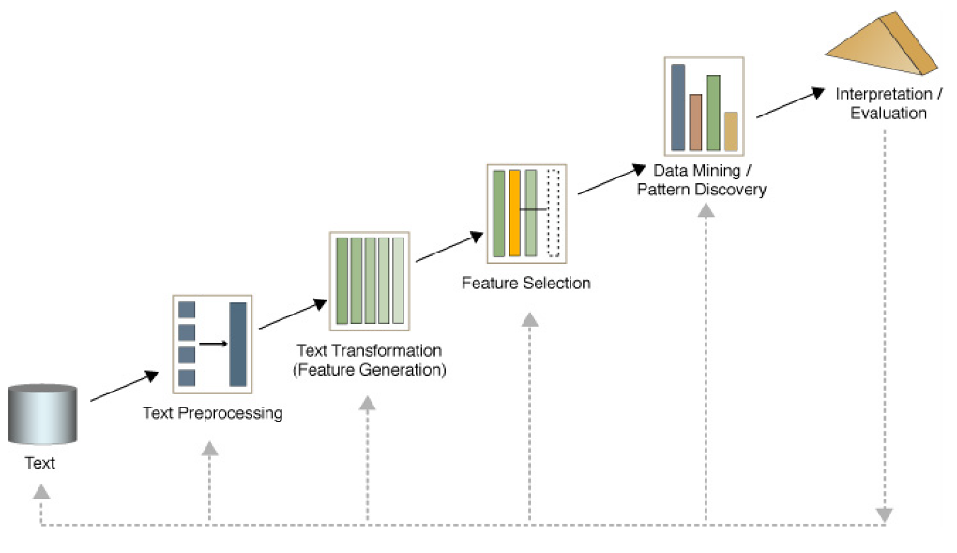
Text mining process

Slide 4
Feature Selection

Slide 5
What is feature selection?
Assume we have some data, and we want to use it to build a classifier, so that to predict something (e.g. email spam classification)
The data has 10,000 features (e.g., token frequencies)
We need to cut it down to 1,000 features before we try classification (data mining/pattern discovery). Which 1,000?
The process of choosing the 1,000 features to use is called Feature Selection

Slide 6
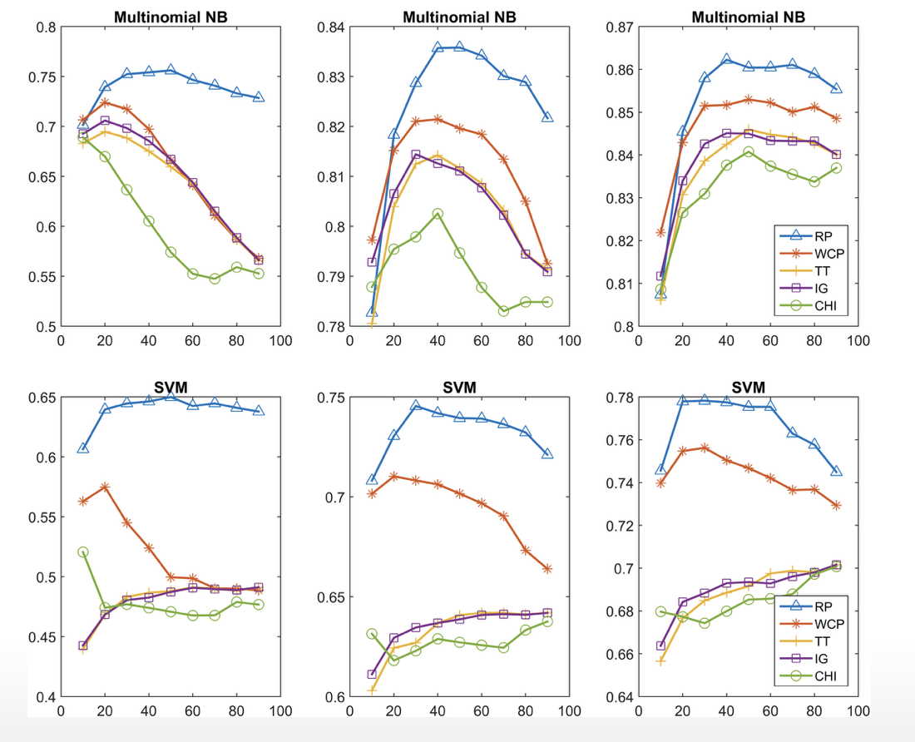
Feature selection vs accuracy
Relevance popularity: A term event model based feature selection scheme for text classification:
https://doi.org/10.1371/journal.pone.0174341
Notes:
Newsgroups: The classification accuracy values of the five feature selection methods when using the Multinomial NB classifier. All of the methods obtained better results when the size of the training set increased.
Newsgroups: The classification accuracy values of the five feature selection methods when using the SVM classifier.

Slide 7
Why accuracy is reduced?
Suppose the best feature set has 20 features.
If you add another 5 features, typically the accuracy of machine learning may reduce.
But you still have the original 20 features!
Why does this happen?

Slide 8
Noise
The additional features typically add noise. Machine learning will pick up on spurious correlations, that might be true in the training set, but not in the test set.
For some ML methods, more features means more parameters to learn (more NN weights, more decision tree nodes, etc…)
The increased space of possibilities is more difficult to search.

Slide 9
Why do we need feature selection?
To improve performance (predictive power).
Simplicity of the model (improves efficiency)
To visualize the data for model selection.
To reduce dimensionality and remove noise.
Notes:
Removing redundant or irrelevant features reduces the complexity of computations, speeding up both training and inference times.
Reducing the number of features leads to simpler models, which are easier to interpret, debug, and deploy.
Feature selection aids data visualization, allowing us to explore relationships between different variables and identify patterns.
Feature selection helps match the dataset to the appropriate ML model

Slide 10
Feature selection in text
Feature Selection is a process that chooses an optimal subset of features according to a certain criterion.
Feature selection is the process of selecting a specific subset of the terms of the training set and using only them in the classification algorithm.

Slide 11
Feature selection in text
Select the most informative features for model training
Reduce noise in feature representation
Improve final classification performance
Improve training/testing efficiency
Less time complexity
Fewer training data

Slide 12
Feature Selection Methods

Slide 13
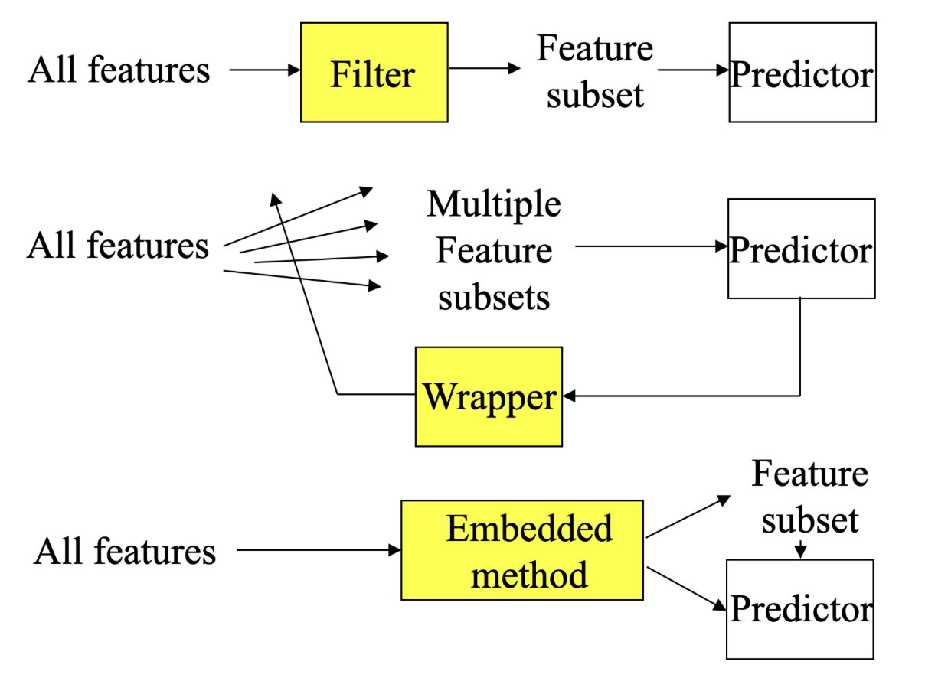
Feature selection methods
Notes:
Filter methods evaluate the relevance of features based on statistical tests without involving any machine learning model. These methods rank features based on their relationship with the target variable.
Wrapper methods train models iteratively with different subsets of features and evaluate their performance. This method searches for the best feature subset by optimizing a model’s performance metric
Embedded methods integrate feature selection into the model training process. The model learns which features are important as part of optimization.

Slide 14
Filter Methods

Slide 15
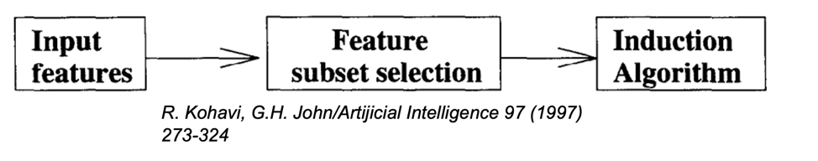
Filter method
Evaluate the features independently from the classifier and other features
No indication of a classifier’s performance on the selected features
No dependency among the features
Feasible for very large feature set

Slide 16
Filter methods
Document frequency
Gini index
Information gain
Chi-Square (χ²)
PMI (Point-wise Mutual information)
and more

Slide 17
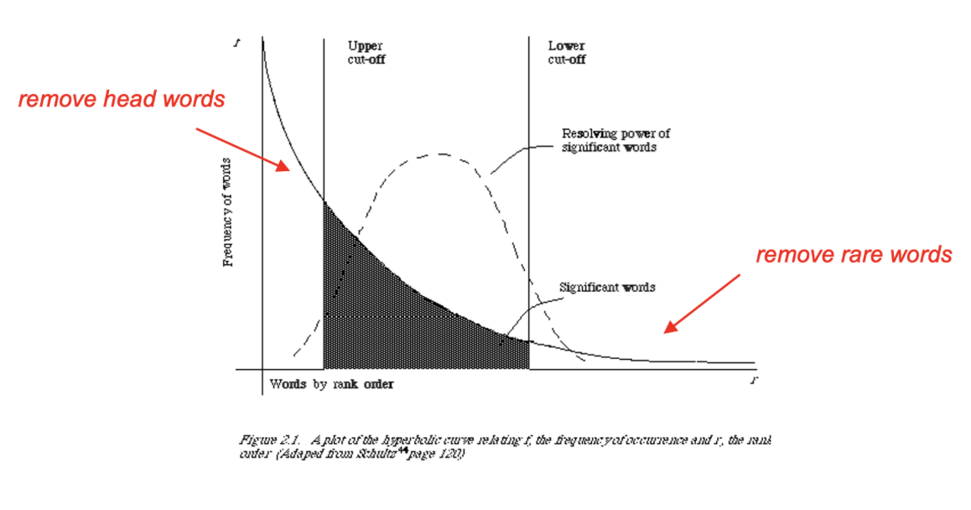
Document frequency
Rare words: non-influential for global prediction, reduce vocabulary size

Slide 18
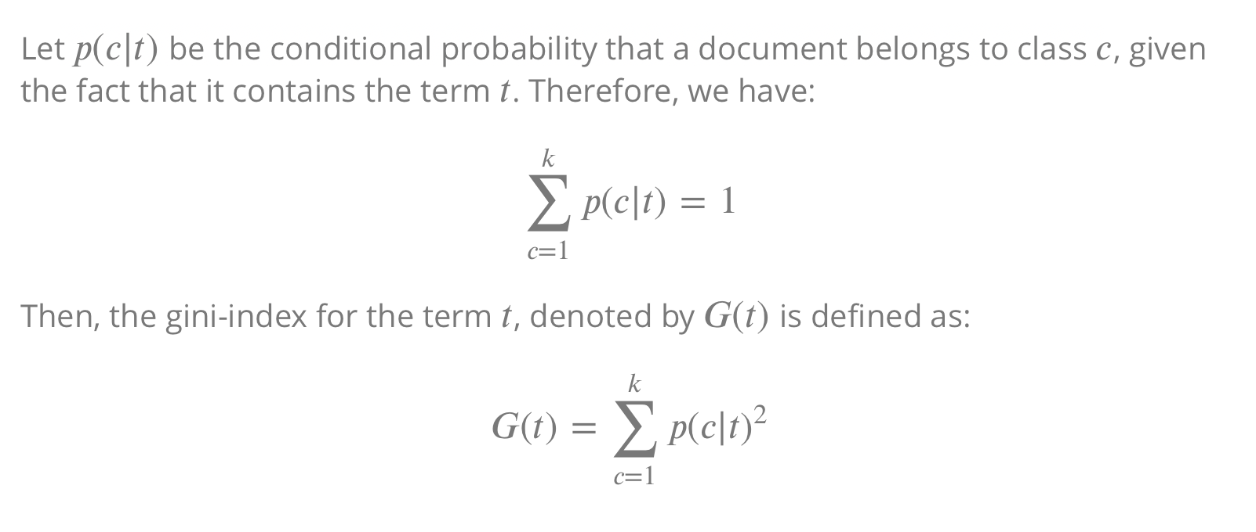
Gini index
Notes:
In filter-based feature selection, the Gini Index can help rank and select features that contribute most to class separation.

Slide 19
Example
Imagine we have the following emails:
Class | Email
Spam | Congratulations! You've been selected to receive a free gift.
Spam | Get a free trial of our exclusive protein supplemment
Spam | We invite you to the VIP club and enjoy free gifts and discounts weekly
Not Spam | Join us for a free community yoga class this Saturday. All levels welcome
Not Spam | I want to invite you to the book club meeting next Thursday.
Not Spam | Join us to our annual family BBQ. Don't miss out on the fun
G(“free”) = ?
p(spam|free) =?
p(not spam|free) = ?

Slide 20
Example
Imagine we have the following emails:
Class
Spam | Congratulations! You've been selected to receive a free gift.
Spam | Get a free trial of our exclusive protein supplemment
Spam | We invite you to the VIP club and enjoy free gifts and discounts weekly
Not Spam | Join us for a free community yoga class this Saturday. All levels welcome
Not Spam | I want to invite you to the book club meeting next Thursday.
Not Spam | Join us to our annual family BBQ. Don't miss out on the fun
p(spam|free) =?
p(not spam|free) = ?
p(spam|free) = ¾ = 0.75
p(not spam|free) = ¼ = 0.25
G(free) = 0.75² + 0.25² = 0.5625 + 0.0625 = 0.625

Slide 21
Example
Imagine we have the following emails:
Class
Spam | Congratulations! You've been selected to receive a free gift. Click the link to claim your prize.
Spam | Get a free trial of our exclusive protein supplemment
Spam | We invite you to the VIP club and enjoy free gifts and discounts weekly
Not Spam | Join us for a free community yoga class this Saturday. All levels welcome
Not Spam | I want to invite you to the book club meeting next Thursday. Looking forward to it
Not Spam | Join us to our annual family BBQ. Don't miss out on the fun
G(invite) = ?
G(join) = ?

Slide 22
Example
Imagine we have the following emails:
Class
Spam | Congratulations! You've been selected to receive a free gift. Click the link to claim your prize.
Spam | Get a free trial of our exclusive protein supplemment
Spam | We invite you to the VIP club and enjoy free gifts and discounts weekly
Not Spam | Join us for a free community yoga class this Saturday. All levels welcome
Not Spam | I want to invite you to the book club meeting next Thursday. Looking forward to it
Not Spam | Join us to our annual family BBQ. Don't miss out on the fun
G(invite) = 0.5² ⁺ 0.5² = 0.5
G(join) = ?

Slide 23
Example
Imagine we have the following emails:
Class
Spam | Congratulations! You've been selected to receive a free gift. Click the link to claim your prize.
Spam | Get a free trial of our exclusive protein supplemment
Spam | We invite you to the VIP club and enjoy free gifts and discounts weekly
Not Spam | Join us for a free community yoga class this Saturday. All levels welcome
Not Spam | I want to invite you to the book club meeting next Thursday. Looking forward to it
Not Spam | Join us to our annual family BBQ. Don't miss out on the fun
G(invite) = 0.5² + 0.5² = 0.5
G(join) = 0² + 1² = 1
G(join) > G(invite) means that join has a greater discriminative power than invite.

Slide 24
Gini index
The value of the gini-index lies in the range (1/𝑘,1).
Higher values of the gini-index indicate a greater discriminative power of the term 𝑡.

Slide 25
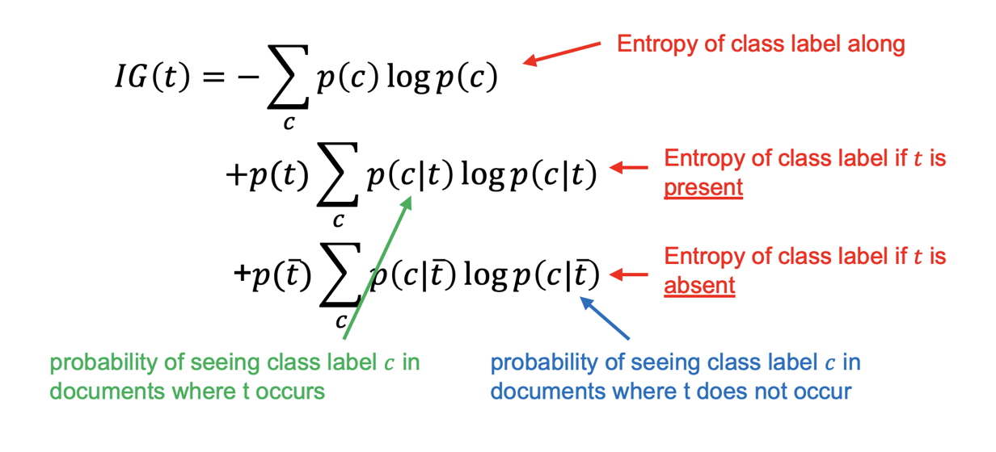
Information gain
Decrease in entropy of categorical prediction when the feature is present or absent.
Notes:
Information Gain (IG) is a measure used in feature selection to determine how much a given feature reduces uncertainty (entropy) in a classification problem. It helps identify the most informative features for the model.

Slide 26
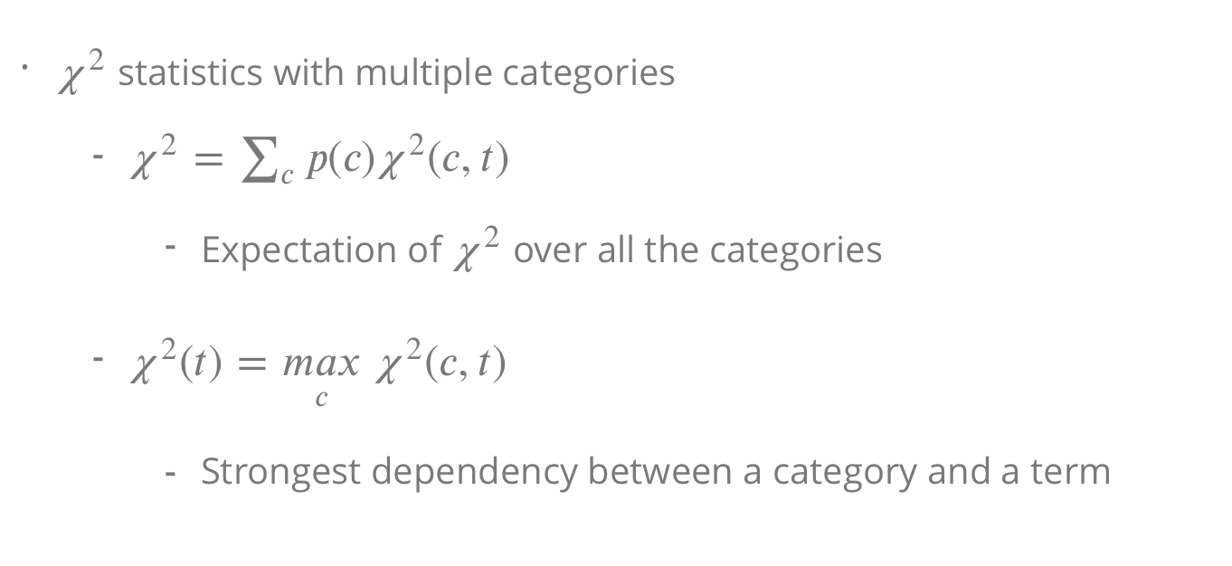
Chi-square
This term calculates how strongly a feature is associated with a particular class
Notes:
Chi-Square (χ2):
It measures the dependence between a feature (word) and the class label (e.g., spam vs. not spam). A higher χ2score means the word is more strongly associated with the class.
If a term tt is strongly associated with a particular class (e.g., "free" with spam), the Chi-Square score χ2(c,t)χ2(c,t)will be high.However, if the class is very rare (low p(c)p(c)), the contribution is downweighted to prevent rare classes from dominating the selection.This ensures that the final feature importance score χ2χ2 is a balanced measure across all classes.

Slide 27
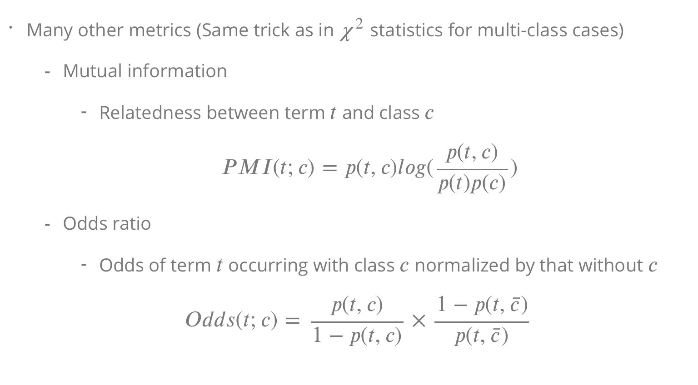
PMI
High PMI indicates a strong association between the term and the class.
Notes:
Mutual Information measures how much knowing a feature (e.g., a word appearing in an email) reduces uncertainty about the class (e.g., whether the email is spam).
High MI means the feature strongly affects classification.
Low MI means the feature is almost independent of the class.
The Odds Ratio (OR) measures how much more likely a feature appears in one class versus another.

Slide 28
PMI example
 | Spam | Not Spam | Total
Offer is present | 120 | 10 | 130
Offer is absent | 180 | 190 | 370
Total | 300 | 200 | 500
PMI(offer, spam)= ?
- p(offer, spam)= 120/500 = 0.24
- p(offer)= 130/500 = 0.26
- p(spam)= 300/500 = 0.60
PMI(offer, spam)= 0.24 * log($\frac{0.24}{0.26 ∗0.6}$) = 0.24 * 0.431 = 0.1

Slide 29
PMI
 | Spam | Not Spam | Total
Offer is present | 120 | 10 | 130
Offer is absent | 180 | 190 | 370
Total | 300 | 200 | 500
PMI(offer, not spam)= ?
- p(offer, not spam)= ?
- p(offer)= ?
- p(not spam)= ?

Slide 30
PMI
 | Spam | Not Spam | Total
Offer is present | 120 | 10 | 130
Offer is absent | 180 | 190 | 370
Total | 300 | 200 | 500
PMI(offer, not spam)= ?
- p(offer, not spam)= 10/500 = 0.02
- p(offer)= 130/500 = 0.26
- p(not spam)= 200/500 = 0.4
PMI(offer, Not Spam) = 0.02 * log($\frac{0.02}{0.26 ∗0.4}$) = 0.02 * (-0.678) = - 0.013

Slide 31
Break

Slide 32
Wrapper Methods

Slide 33
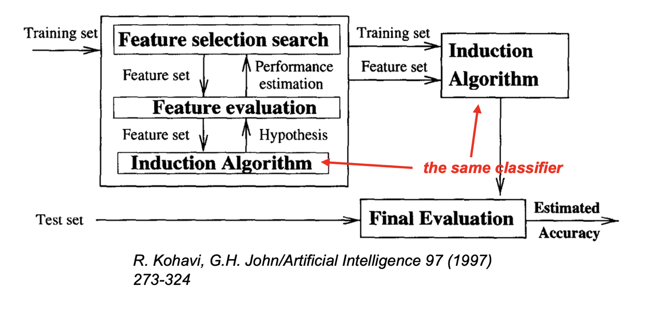
Wrapper method
Find the best subset of features for a particular classification method
Notes:
The wrapper method in feature selection is an approach that relies on using a predictive model to assess the significance of different subsets of features. It involves selecting and evaluating the effectiveness of combinations of features directly based on the performance they produce when applied to a specific model. This method "wraps" around the learning algorithm, hence the name.

Slide 34
Wrapper method
Optimizes feature set for a specific learning algorithm
The feature subset selection algorithm is a “wrapper” around the learning algorithm
Pick a feature subset and pass it in to a learning algorithm
Create training/test set based on the feature subset
Train the learning algorithm with the training set
Find accuracy (objective) with validation set
Repeat for all feature subsets and pick the feature subset which led to the highest predictive accuracy (or other objective)

Slide 35
Wrapper method
Basic approach is simple
Variations are based on how to select the feature subsets, since there are an exponential number of subsets

Slide 36
Wrapper method
Wrapper methods evaluate feature subsets using a specific learning algorithm, which often results in optimal performance for that particular model
Consider all possible dependencies among the features
Flexible: Can be used with any model and is adaptable to the problem at hand

Slide 37
Wrapper method
Impractical for text classification
Cannot deal with large feature set
A NP-complete problem
Given a dataset with N features, the number of possible feature subsets is 2^{N}.
For large n, exhaustively evaluating all subsets becomes computationally infeasible.
Notes:
NP (nondeterministic polynomial time). :

Slide 38
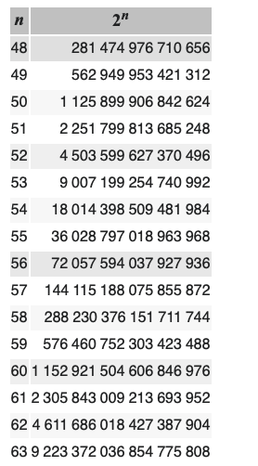
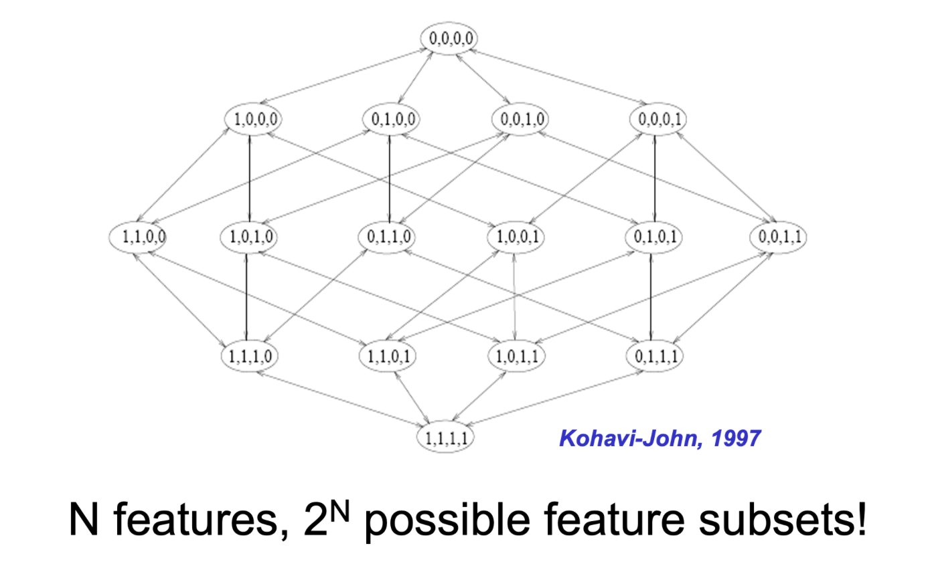
Wrapper method
2¹⁰ is 1024
2²⁰ is 1.048.576

Slide 39
Wrapper method
Evaluating all possible subsets can be computationally expensive, especially with a large feature set, as each evaluation requires training a model.
Risk of overfitting: Tuning the model too closely to the training data can lead to overfitting, as the method seeks feature sets that maximize training performance rather than generalization.
Changing the selection of the algorithm require re-evaluation of the feature selection process.

Slide 40
Search strategies
Exhaustive search
Greedy search: forward selection or backward elimination
Simulated annealing
Genetic algorithms
These will not be discussed in this course.
Notes:
Exhaustive search: Evaluates all possible feature subsets
Greedy search: A faster alternative to exhaustive search, but it does not guarantee the global optimum.
Simulated annealing: A probabilistic search algorithm (starts with random feature subset, makes random changes)
Genetic algorithms: Inspired by natural selection, genetic algorithms evolve feature subsets over multiple generations to find the best one. Start with random feature subsets (population).

Slide 41
Embedded Methods

Slide 42
Embedded Methods
The process of selecting features is integrated with the model training process itself.
Embedded methods include feature selection as part of the model optimization process.
The model focuses only on the most relevant features and often results in better performance with reduced computational cost compared to wrapper methods.
Notes:
Embedded methods combine feature selection with model training, meaning that the selection process happens as the model learns. These methods are more efficient than wrapper methods and more accurate than filter methods since they integrate feature selection directly into the learning process.

Slide 43
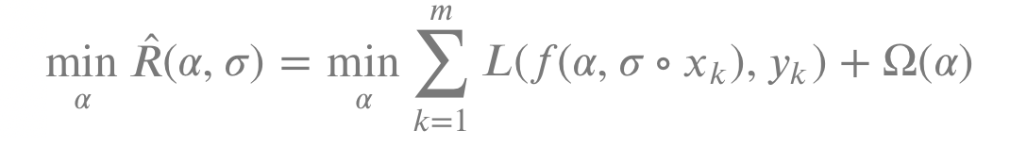
Formalism
Many learning algorithms are cast into a minimization of some regularized functional:
The loss function measures how far off the model's predictions are from the actual values, aiming to minimize this difference.
The regularization term adds a penalty to prevent the model from becoming overly complex, promoting simplicity and better generalization.
Loss function
Regularization Term
Notes:
This equation is about improving a machine learning model by finding the best settings (parameters) that make accurate predictions on data. It does this by minimizing errors (the difference between predictions and actual values) while also keeping the model simple to avoid mistakes on new data. A special part of the equation helps decide which pieces of information (features) are most important to use. It uses a penalty to discourage complexity, ensuring the model isn't too complex and can perform well on new, unseen data.
The penalty discourages the model from becoming too complex by adding a cost to certain configurations of the model parameters, \(\alpha\).
The goal is to find the parameters \(\alpha\) that minimize the objective function
The loss function evaluates the difference between the predicted values \(f(\alpha, \sigma \circ x_k)\) and the actual values \(y_k\).
**Regularization Term**:
- \(\Omega(\alpha)\): \(\alpha\), such as its norm. It helps prevent overfitting by discouraging overly complex models.
A regularization function that penalizes certain aspects of

Slide 44
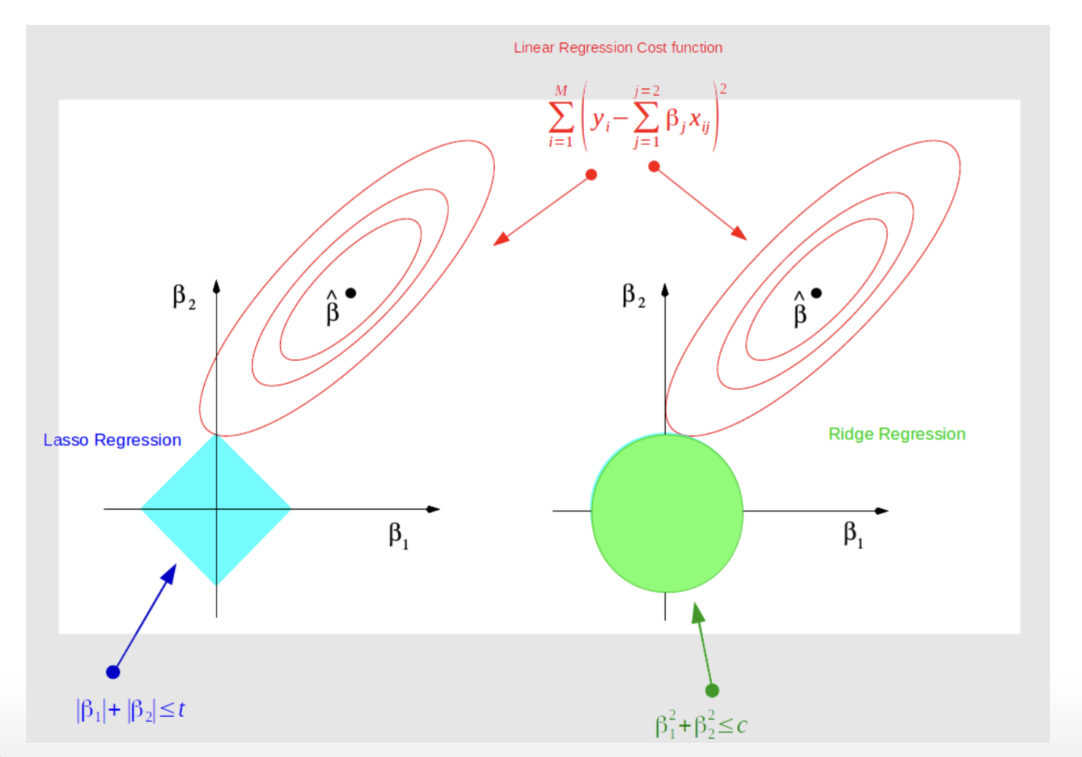
Lasso & Ridge regression
Notes:
This image visualizes the difference between LASSO and Ridge regression in terms of their regularization constraints:
- **LASSO Regression** (left): The constraint is shown as a diamond (\(|\beta_1| + |\beta_2| \leq t\)). This \(L1\) regularization leads to sparsity, potentially setting some coefficients to zero, which can result in feature selection.
- **Ridge Regression** (right): The constraint is depicted as a circle (\(\beta_1^2 + \beta_2^2 \leq c\)). This \(L2\) regularization shrinks coefficients towards zero evenly but does not eliminate them, helping with multicollinearity.
- **Ellipses**: Both methods aim to find the point where the cost function intersects with these constraints, balancing fit and complexity.

Slide 45
Toy example: LASSO as embedded feature selection
Movie review classification with two classes (positive and negative), and three features (words):
good
bad
movie
Notes:
Embedded methods combine feature selection with model training, meaning that the selection process happens as the model learns. These methods are more efficient than wrapper methods and more accurate than filter methods since they integrate feature selection directly into the learning process.

Slide 46
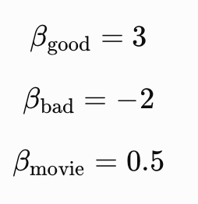

Toy example: LASSO as embedded feature selection
For simplicity, suppose fitting a model without regularization (embedded fs) gives:
Notes:
Embedded methods combine feature selection with model training, meaning that the selection process happens as the model learns. These methods are more efficient than wrapper methods and more accurate than filter methods since they integrate feature selection directly into the learning process.

Slide 47
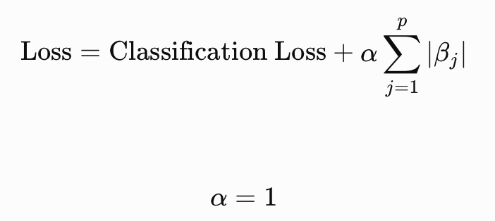
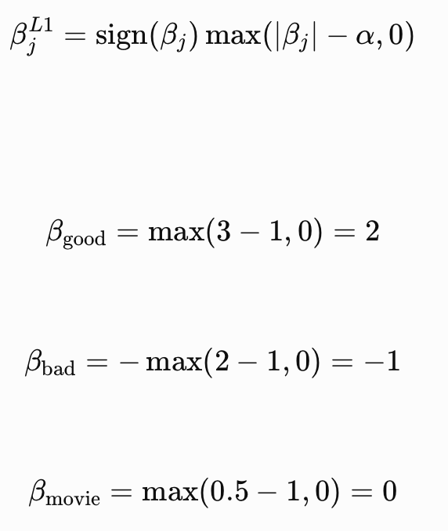
Toy example: LASSO as embedded feature selection
Now we train the model with Lasso L1 regularization:
Notes:
Embedded methods combine feature selection with model training, meaning that the selection process happens as the model learns. These methods are more efficient than wrapper methods and more accurate than filter methods since they integrate feature selection directly into the learning process.

Slide 48
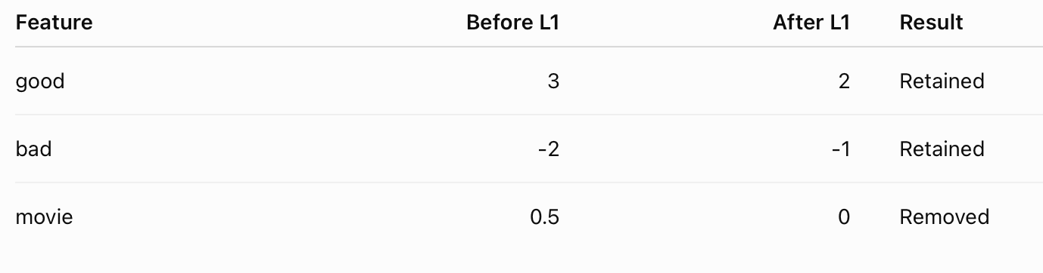
Toy example: LASSO as embedded feature selection
This is called embedded feature selection because feature selection happens as part of the model-training process.
Notes:
Embedded methods combine feature selection with model training, meaning that the selection process happens as the model learns. These methods are more efficient than wrapper methods and more accurate than filter methods since they integrate feature selection directly into the learning process.

Slide 49
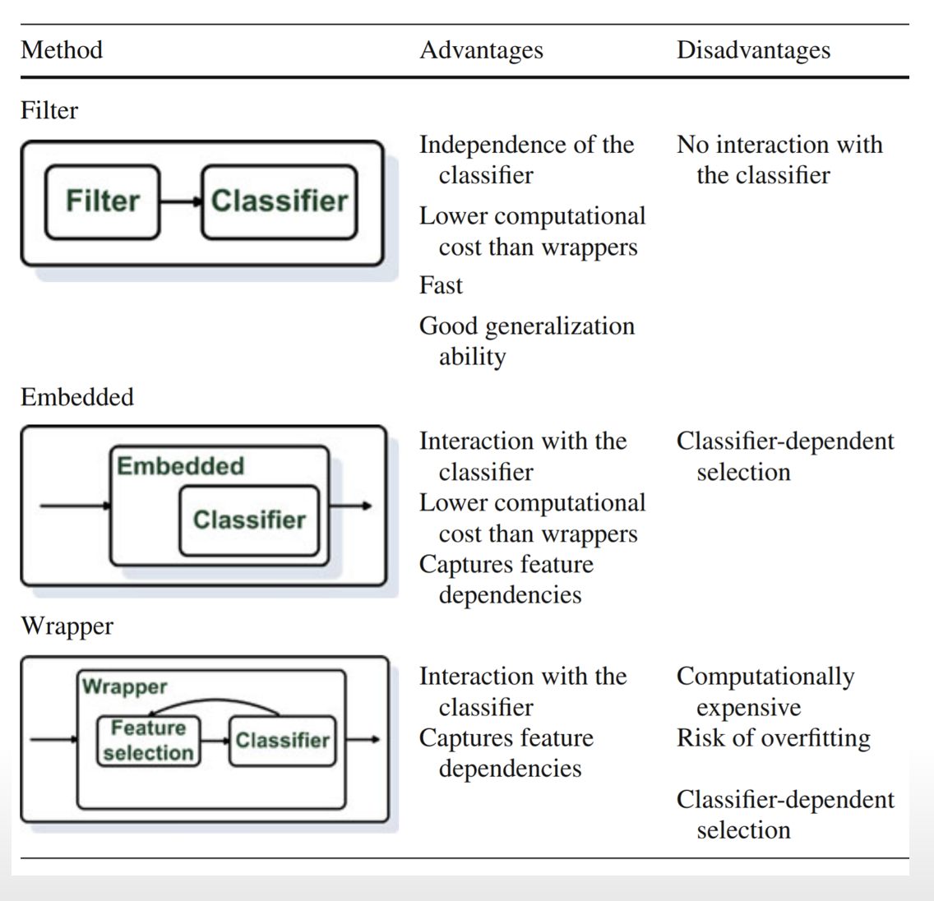
Comparing methods

Slide 50
Feature Reduction

Slide 51
Feature selection vs feature reduction
Feature Selection seeks a subset of the 𝑛 original features which retains most of the relevant information
Wrappers (e.g. forward selection), Filters (e.g. PMI), Embedded (e.g. Lasso, Regularized SVM)
Feature Reduction combines/fuses the 𝑛 original features into a smaller set of newly created features which hopefully retains most of the relevant information from all the original features (e.g. LDA, PCA, etc.)

Slide 52
PCA: Principal Component Analysis
PCA is a dimensionality / feature reduction technique that transforms high-dimensional text features (e.g., term-frequency matrices) into a smaller set of uncorrelated components, preserving as much variance as possible.
It helps in reducing redundancy and noise, making models more efficient while retaining key information for analysis.

Slide 53
PCA: Principal Component Analysis
PCA is a linear method for dimensionality reduction, finds a sequence of linear combinations of features that have maximum variance and are uncorrelated
Allows to combine much of the information contained in 𝑛 features into 𝑝 features where 𝑝<𝑛
PCA is unsupervised in that it does not consider the output class / value of an instance – There are other algorithms which do (e.g. LDA: Linear Discriminant Analysis)
PCA works well in many cases where data have mostly linear correlations.

Slide 54
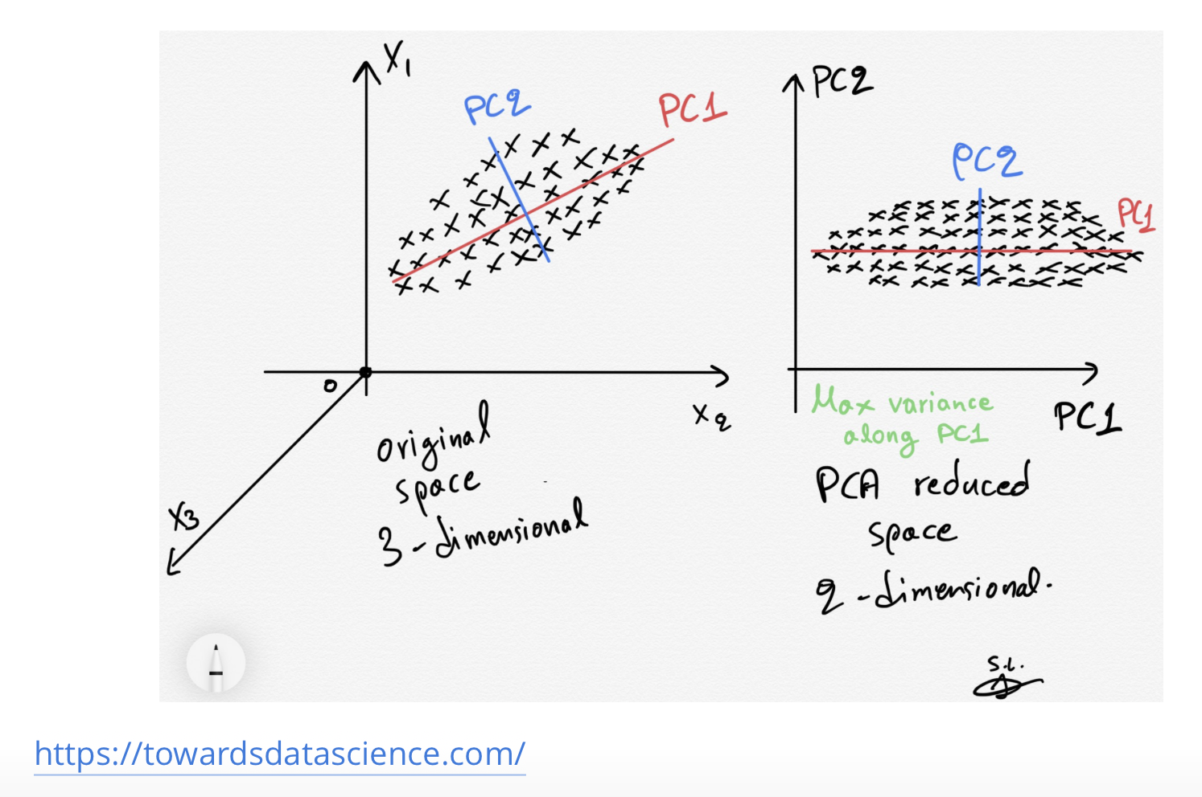
PCA overview

Slide 55
PCA Advantages & Disadvantages
Advantages:
Reduces the number of features while preserving as much variance as possible, simplifying data and computational requirements.
Eliminates noise and redundant features
Better visualization of high-dimensional data by projecting it into 2D or 3D plots.
Disadvantages:
Interpretability: Principal components are linear combinations of original features, making them hard to interpret in terms of the original feature set.
Reducing dimensions might lead to the loss of some information

Slide 56
Summary
Feature selection is the process of identifying and choosing the most relevant features in a dataset to improve model performance and efficiency
Feature selection methods:
Filter methods (e.g., Mutual Information, Chi-Square)
Wrapper methods (e.g., Forward/Backward Selection)
Embedded methods (e.g., LASSO, RIDGE)

Slide 57
Summary
Reducing the dimensionality of text features helps improve:
Computational efficiency
Making models faster
Improve performance
And more scalable.

Slide 58
Practical 3

Slide 59
Questions?

